Slide 1
Docker

Slide 2
Docker Overview
Docker is an open source platform for developing containerized applications. One can package and run the application in a container and one of the plus point is to ship the application and run in any environment without setting additional infrastructure for applications. One can run as many containerized applications on same host as these take lightweight apps taking little resources.
One can share the containers with other developers and everyone gets the same configuration settings letting them to run application seamlessly without additional config.

Slide 3
Docker Benefits
Responsive deployment and scaling – Docker based workloads can be easily scaled and are highly portable and can be run on variety of hosts like Cloud VM, personal laptops and data centers.
Running more workloads on the same hardware - Docker is lightweight and fast. It takes resources like any normal application takes on any machine enabling businesses to run multiple workloads for small and medium resources with efficient utilisation of resources on host machine.

Slide 4
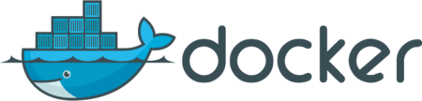
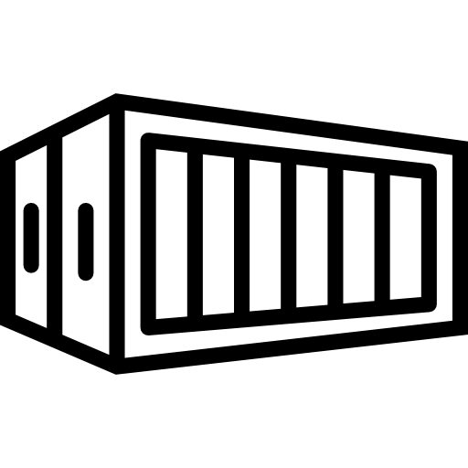
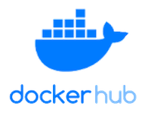
Docker Architechture
DOCKER HOST
Docker Client
Docker Daemon
Docker Registry
docker build
docker pull
docker run
Containers
Images

Slide 5
Docker Components
Docker daemon - The docker daemon (dockerd) is heart of docker and listens for Docker API requests and manages docker objects such as images, containers, networks, and volumes. A daemon can also communicate with other daemons to manage docker services.
Docker client - The Docker client (docker) is the primary way to interact with docker daemon. The client sends commands to docker daemon, which carries them out. The docker command uses the Docker API. The Docker client can communicate with more than one daemon.
Docker registries - A Docker registry stores Docker images. Docker Hub is a public registry that anyone can use, and Docker is configured to look for images on Docker Hub by default.
Docker objects
- Images - An image is a read-only template with instructions for creating containers.
- Containers - A container is a runnable instance of an image. One can create, start, stop, move, or delete a container using the docker API or CLI.

